Slide 1

Lecture 1 Introduction to java development

Slide 2
Course Objectives
Upon completing the course, you will understand
Create, compile, and run Java programs
Primitive data types
Java control flow
Methods
Arrays
Object-oriented programming
Core Java classes (Swing, exception, internationalization, multithreading, JDBC)

Slide 3
Course Objectives, cont.
You will be able to
Develop programs using Netbeans
Write simple programs using primitive data types, control statements, methods, and arrays.
Create and use methods
Establish a firm foundation on Java concepts

Slide 4
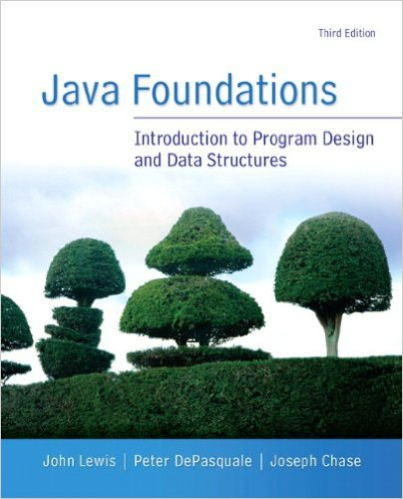
Java Foundations, An Introduction to Program Design and Data Structures, Lewis, DePasquale and Chase,
Third Edition, Pearson Education Inc., 2014 ISBN-10: 0133370461 or ISBN-13: 9780133370461

Slide 5
Overview
Learning about programming
Introduction to JAVA
Basics of Java:
Features of Java,
Program Life Cycle,
Byte Code
Java Virtual Machine
JDK
Simple programs in netbeans

Slide 6
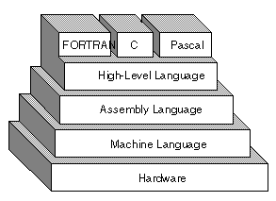
Learning about programming
A computer program
Its a set of instructions that you write to tell a computer what to do.
Types of programming languages
Low level Language : Program written in sequence of 1’s and 0’s
Assemble Level Language : uses a mnemonic to represent each low-level machine instruction (specific to a particular computer architecture)
High Level Language : use natural language elements, be easier to use

Slide 7
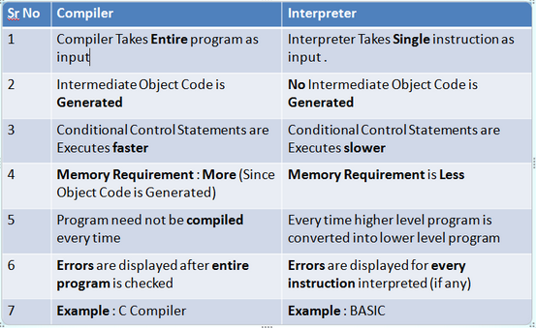
Learning about programming
A program needs compiler or interpreter to translate their language statements into machine code

Slide 8

Why learn java??

Slide 9
Why learn java??
General-purpose language was designed to be easier to use than C++
3rd Most Demanded Skill on Angel list.
Many tech giants such as Google or Amazon also use Java to develop the backend of their websites
According to Indeed.com, Java developers are in high demand compared to other programmers:

Slide 10
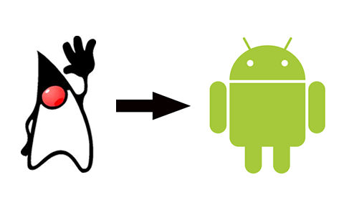
Reasons to choose
Lots of information
An incredible toolset
Killer editors
Omnipresence (Java community to be the leader of the IOT )
Android adoption
Ease of learning

Slide 11
Introduction to java
High-level programming language
Developed by James Gosling at Sun Microsystems in 1995
Write Once, Run Anywhere (WORA)
Develop and compile a program once,
Run it on a wide variety of machines and operating systems. Windows, Mac OS, and the various versions of UNIX.
A Java program is compiled into a sequence of instructions known as BYTE CODE than executed in the Java virtual machine (JVM)

Slide 12
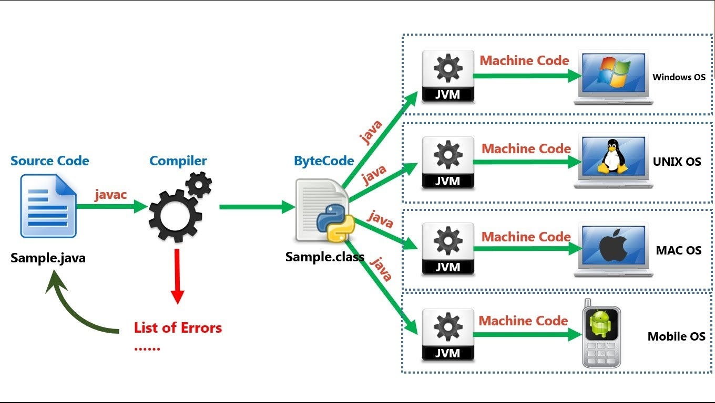
Introduction to java
Notes:
javac which convert source code to intermediate code which is know as java bytecode. This java bytecode is not dependent on any platform
virtual machine is available to convert intermediate code into the native code. The bytecode then is compiled to machine-code using a Just-In-Time compiler within the JVM

Slide 13
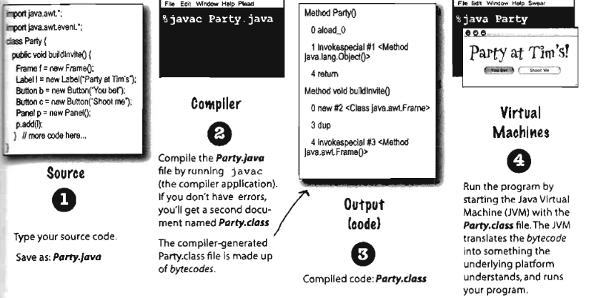

Slide 14
JAVA TERMINILOGY : Java virtual machine (JVM)
Abstract machine.
Provides runtime environment in which java BYTECODE can be executed.
The JVM performs following main tasks:
Loads code
Verifies code
Executes code
Provides runtime environment

Slide 15
Java Runtime Environment (JRE)
It’s a runtime environment which implements JVM.
Provides platform core classes and supporting libraries
It does not contain any development tools like compiler , debugger etc
Part of the java development kit (JDK)
Provides the minimum requirements for executing a java application

Slide 16
Java development kit (JDK)
Software development environment
Used for developing java applications and applets.
It includes the
Java runtime environment (JRE),
An interpreter/loader (JAVA),
A compiler (JAVAC), an archiver (JAR),
A documentation generator (JAVADOC)
Other tools needed in java development.

Slide 17
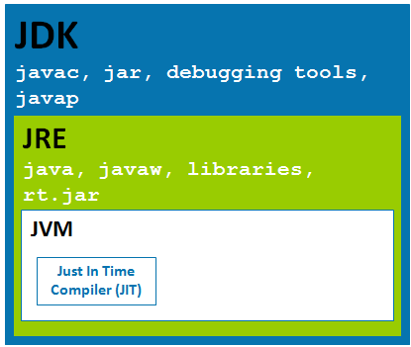
Java terminology

Slide 18
Characteristics of Java
Java is simple
Java is object-oriented
Java is distributed
Java is interpreted
Java is robust
Java is secure
Java is architecture-neutral
Java is portable
Java’s high performance
Java is multithreaded
Java is dynamic

Slide 19
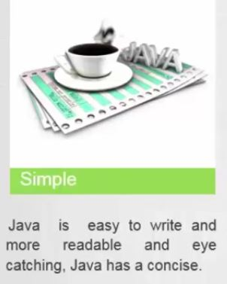
SIMPLE :
Java is designed to be easy to learn with small no of language constructs.
If you understand the basic concept of OOP Java, it would be easy to master.

Slide 20
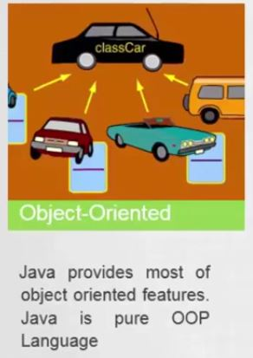
OBJECT ORIENTED
In Java, everything is an Object.
Java can be easily extended since it is based on the Object mode

Slide 21
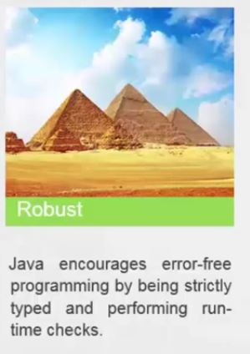
ROBUST

Slide 22

SECURE

Slide 23
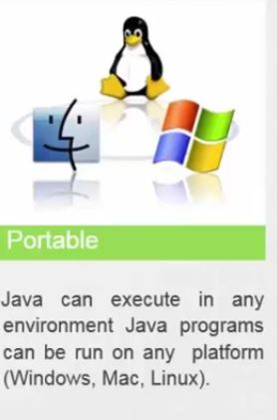
PORTABLE

Slide 24
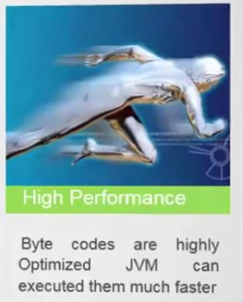
HIGH PERFORMANCE :

Slide 25
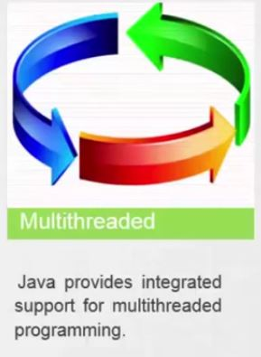
MULTI-THREADED
It is possible to write programs that can perform many tasks simultaneously

Slide 26
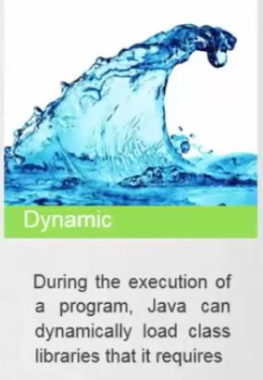
Dynamic

Slide 27
Distributed − java is designed for the distributed environment of the internet.
Interpreted − java byte code is translated on the fly to native machine instructions and is not stored anywhere
Architecture-neutral : java is not tied to specific machine or os architecture. Java compiler generates an architecture-neutral object file format, which makes the compiled code executable on many processors

Slide 28
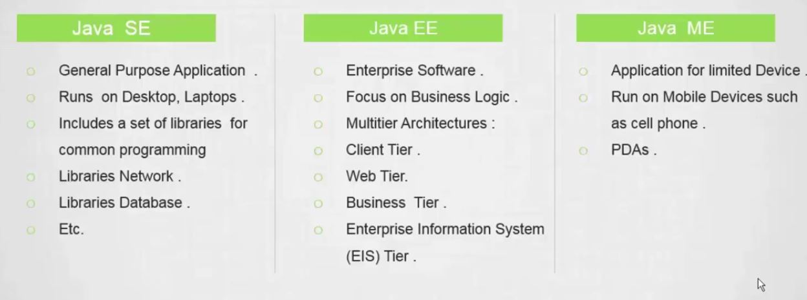
Java Platforms

Slide 29
Installation Tools
1. JDK (directly from the oracle website)
Download JDK according to your OS
run the .exe to install Java on your machine.
Install the java just by clicking next
2. Popular Java Editors
Notepad
NetBeans / Eclipse ( Operating system specific)

Slide 30
Setting Up the Path for Windows
Assuming you have installed Java in c:\Program Files\java\jdk directory
Right-click on 'My Computer' and select 'Properties'.
Click the 'Environment variables' button under the 'Advanced' tab.
Path is :'C:\WINDOWS\SYSTEM32;
Add to that : ‘C:\Program Files\java\jdk\bin'.

Slide 31
Setting Up the Path for Linux, UNIX, Solaris, FreeBSD
If you use bash as your shell, then you would add the following line to the end of your '.bashrc: export PATH = /path/to/java:$PATH‘

Slide 32
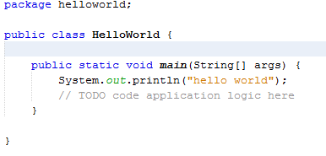
First Java Program
class header
class body
method header

Slide 33
Anatomy of a Java Program
Comments
Package
Reserved words
Modifiers
identifiers
Statements
Blocks
Classes
Methods
The main method

Slide 34
Comments
Inline documentation
Explain the purpose of the program and describe processing steps
They do not affect how a program works
Java comments can take three forms:
// this comment runs to the end of the line
/* this comment runs to the terminating
symbol, even across line breaks */
/** this is a javadoc comment */

Slide 35
Package
Namespace that organizes a set of related classes and interfaces
Different folders on your computer.
Eg: html pages in one folder, images in another, and scripts or applications in yet another.
Bundle groups of related types into packages.

Slide 36
Reserved Words
abstract
assert
boolean
break
byte
case
catch
char
class
const
continue
default
do
double
else
enum
extends
false
final
finally
float
for
goto
if
implements
import
instanceof
int
interface
long
native
new
null
package
private
protected
public
return
short
static
strictfp
super
switch
synchronized
this
throw
throws
transient
true
try
void
volatile
while

Slide 37
Modifiers
Specify the properties of the data, methods, and classes and how they can be used.
Access Modifiers − default, public , protected, private
Non-access Modifiers − final, abstract
PUBLIC
method, or class can be accessed by other programs.
PRIVATE
method cannot be accessed by other programs.

Slide 38
identifiers
Names used for classes, variables, and methods are called identifiers.
begin with a letter (A to Z or a to z), currency character ($) or an underscore (_).
A key word cannot be used as an identifier.
, identifiers are case sensitive.
Examples of legal identifiers:
age, $salary, _value, __1_value.
Examples of illegal identifiers:
123abc, -salary.

Slide 39
Statements
Represents an action or a sequence of actions.
Ex:
System.Out.Println("welcome to java!“)

Slide 40
Blocks
A pair of braces in a program forms a block that groups components of a program.

Slide 41
Classes
Template or blueprint for objects.
A program is defined by using one or more classes.

Slide 42
Methods
What is System.out.println?
It is a method:
A collection of statements that performs a sequence of operations to display a message on the console.
Invoking a statement with a string argument.
The string argument is enclosed within parentheses.
The argument is "welcome to java!”

Slide 43
Main Method
Provides the control of program flow.
Point , where it starts execution.
Ex
public static void main(String[] args) {
// statements;
}

Slide 44

Variables
Each variable has a specific type,
which determines the size and layout of the variable's memory
There are three kinds of variables in Java −
Local variables
Instance variables
Class/Static variables

Slide 45
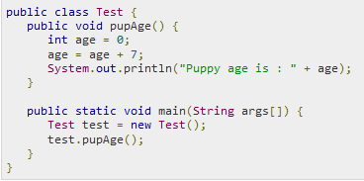
Local Variables
Declared in methods, or block
Created when the method or block is entered and the destroyed once it exits the method or block
No default value for local variables,
An initial value should be assigned before the first use

Slide 46
Instance Variables
Declared in a class, but outside a method
Instance variables are created when an object is created with the use of the keyword 'new‘
For Numbers Default value is 0, for BOOLEANS it is false
Static variables can be accessed by calling with the class name ClassName.VariableName

Slide 47
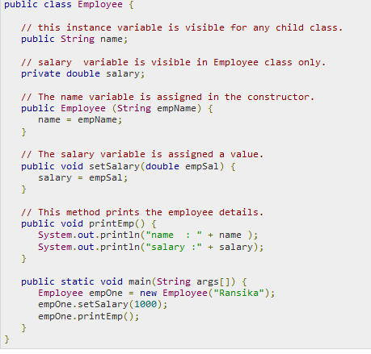

Slide 48
Class/Static Variables
Declared with the static keyword in a class, but outside a method
Only be one copy of each class variable per class,
Static variables are created when the program starts and destroyed when the program stops.
Default values are same as instance variables.
For numbers, the default value is 0; for BOOLEANS, it is false

Slide 49
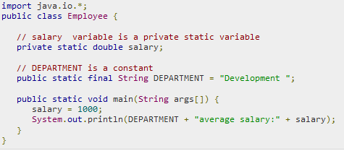

Slide 50
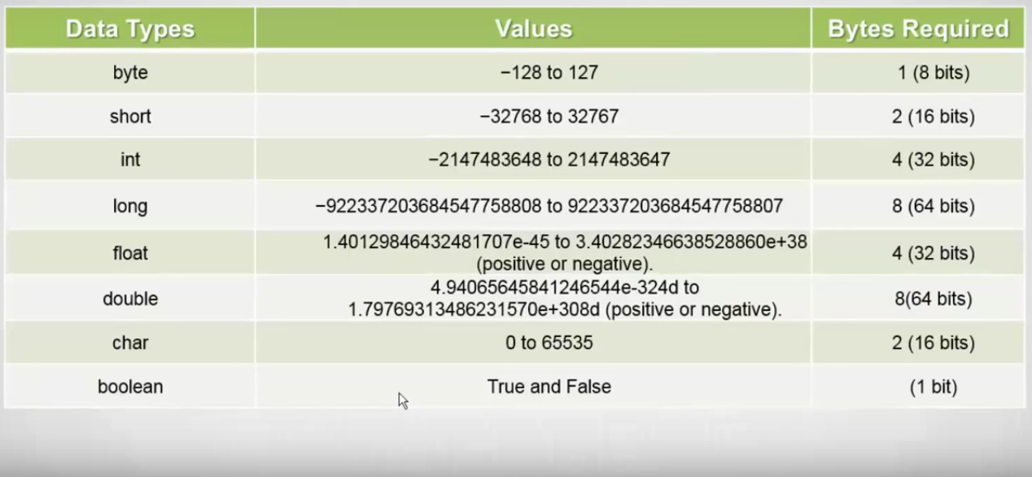
PRIMITIVE DATA TYPES

Slide 51
Basic Operators
Arithmetic Operators
Relational Operators
Logical Operators
Bitwise Operators
Assignment Operators
Misc Operators

Slide 52
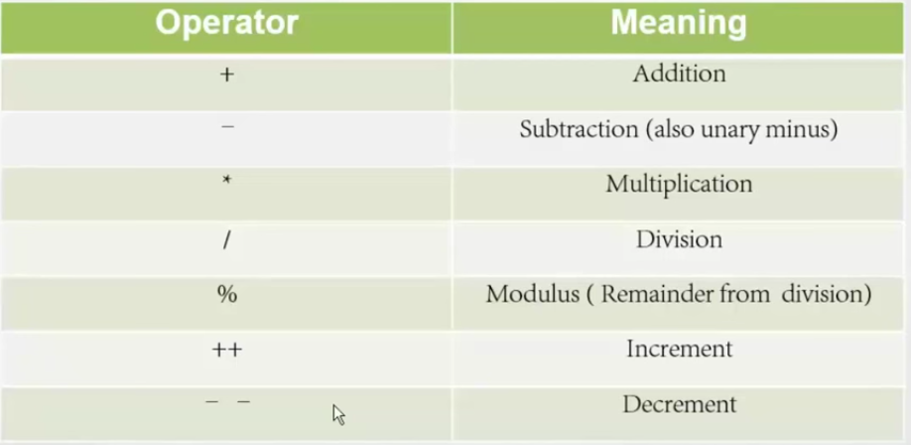
Arithmetic operators

Slide 53
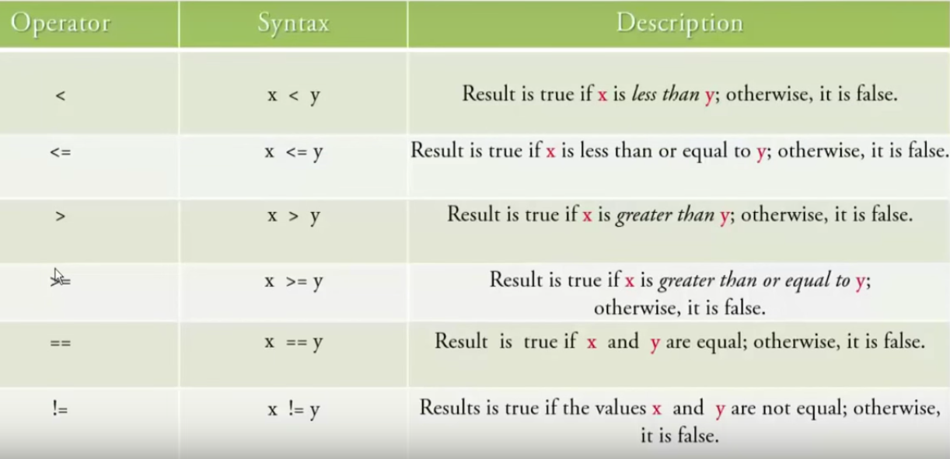
Relational Operators

Slide 54
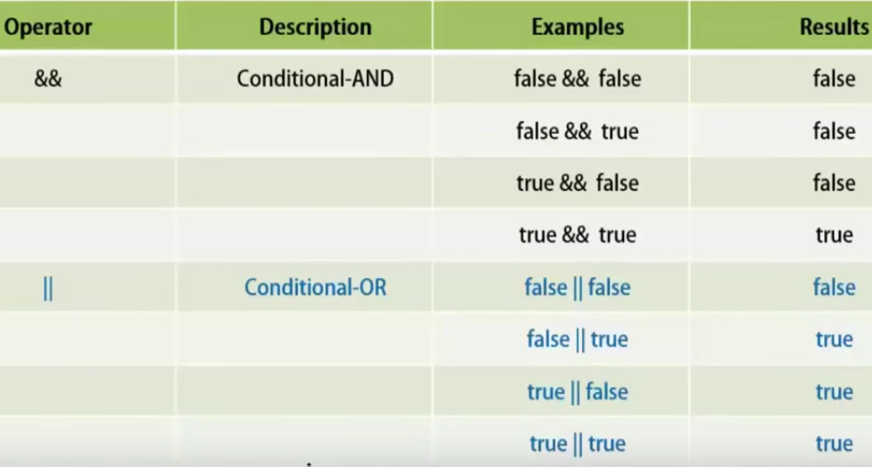
Logical Operators

Slide 55
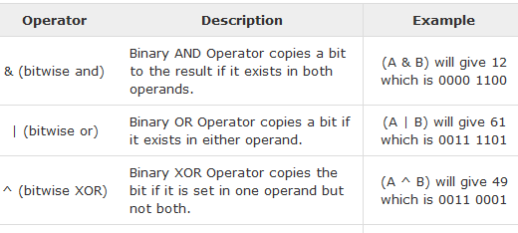
Bitwise Operator
Applied to integer types, long, int, short, char, and byte.
Works on bits and performs bit-by-bit operation
Ex : A = 60 (0011 1100) & B=13 (0000 1101)

Slide 56
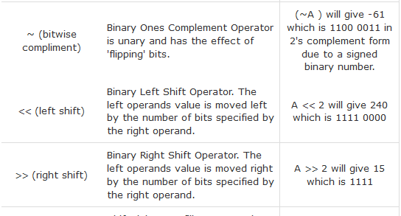
Bitwise Operator

Slide 57
Conditional Operator ( ? : )
three operands and is used to evaluate Boolean expressions
decide, which value should be assigned to the variable
variable x = (expression) ? value if true : value if false
Ex:
a = 10;
b = (a > 1) ? 20: 30;

Slide 58
Taking Input from the console
System.in
not intended to be used directly
We use a second object, from a class Scanner,
to help us.
Constructing a Scanner object to read console input:
Scanner name = new Scanner(System.in);
Example:
Scanner value = new Scanner(System.in);
int a = value.nextInt();

Slide 59
To read a integer number (Pure No)
nextInt();
To read a fractional number
nextDouble();
To read a sentence(string)
nextLine();

Slide 60
Operator Precedence
EX :
int x = 4 + 3 * 5; ???
int x = (4 + 3 ) * 5; ???
int x = 4 + (3 * 5); ????

Slide 61
Operator Precedence
Operator | Operation
( ) | parenthesis for explicit grouping
* / % | multiplication, division, modulus
+ - | addition or String concatenation, subtraction
= += -= *= /= %= | assignment

Slide 62
CLASSES AND OBJECT
Object − Objects have attributes and methods. Example: A car has attributes - color, name, model as well as methods – drive() , brake() , park().
Class − A class can be defined as a blueprint that describes the attributes / methods that the object of its type support.

Slide 63
class Car {
String carname;
String modelname;
int carno;
Void drive()
{
}
Void park()
{
}
}
Attributes
Methods

Slide 64
Car a= new Car();
a.carname = “HYUNDAI”;
a.modelname = “ELANTRA”;
a.carno = 12334;
Car b = new Car();
b.carname =“HONDA”;
b.modelname =“CIVIC”;
b.carno = 23455;

